Slide 1


GIVE NGO

Slide 2
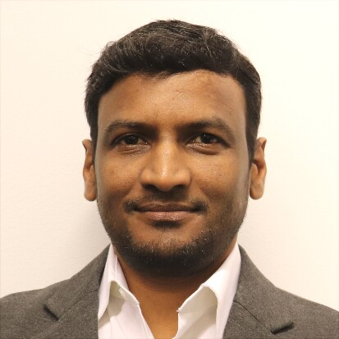
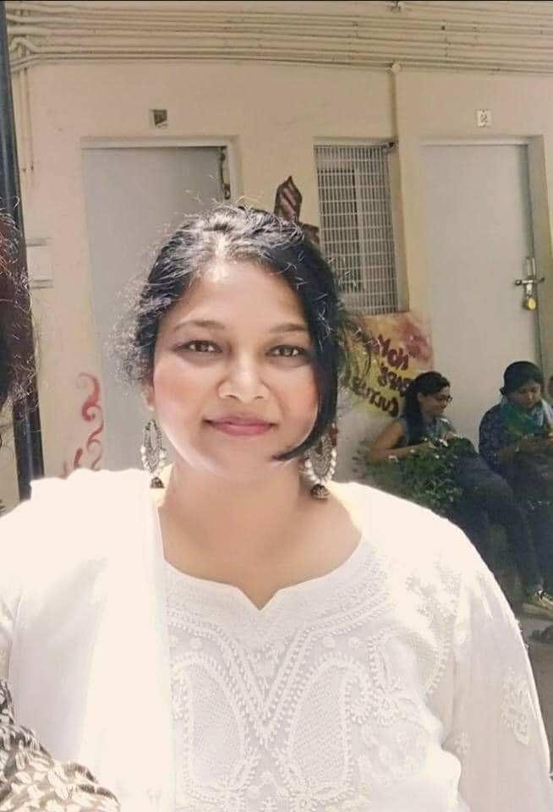
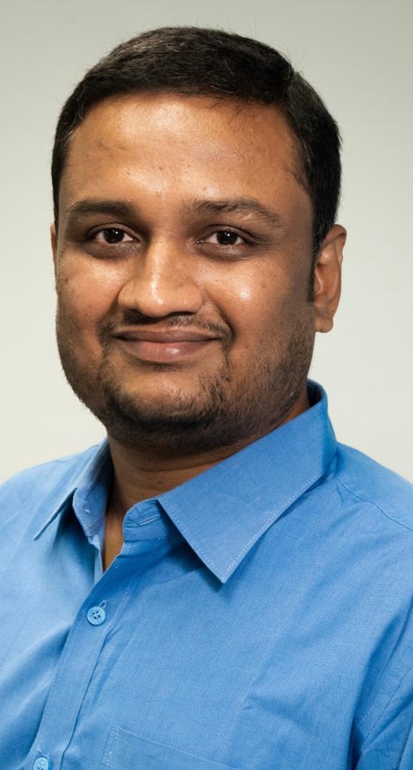
Our Team (1/6)
Satya Rapelly
Founder & President, Give NGO
Satya leverages a rich 25-year background in the software industry to spearhead initiatives focused on empowering the youth and women in rural areas through technology-driven education and a deep understanding of rural socio-economic landscapes.
Sunitha Madhav
Women Wing - Operations and Coordinator
Holding a Doctorate in Sociology from Jawaharlal Nehru University (JNU), New Delhi, and serving as an Assistant Professor at various renowned institutions including the Government of Delhi, she brings a wealth of academic insight and dedication to empowering women through educational avenues. Based in Delhi, Dr. Valentina is deeply committed to fostering socio-economic growth and uplifting communities.
Sajesh Rao Erabelli
Project Lead – Financial Operations
Steering the onshore operations in the USA as the Director for "Give For Society," brings forth a prolific career grounded in a decade of experience in the banking sector at national banks in India. A holder of a Master's degree in Business and Data Science, he pairs his corporate acumen with philanthropy, notably in child education and upskilling initiatives, constantly driven by a rich understanding of diverse socio-economic backgrounds.

Slide 3
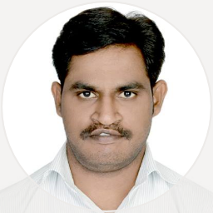
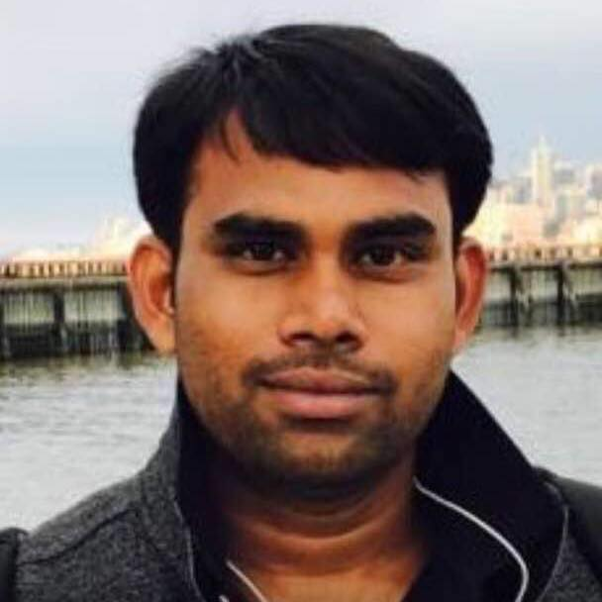
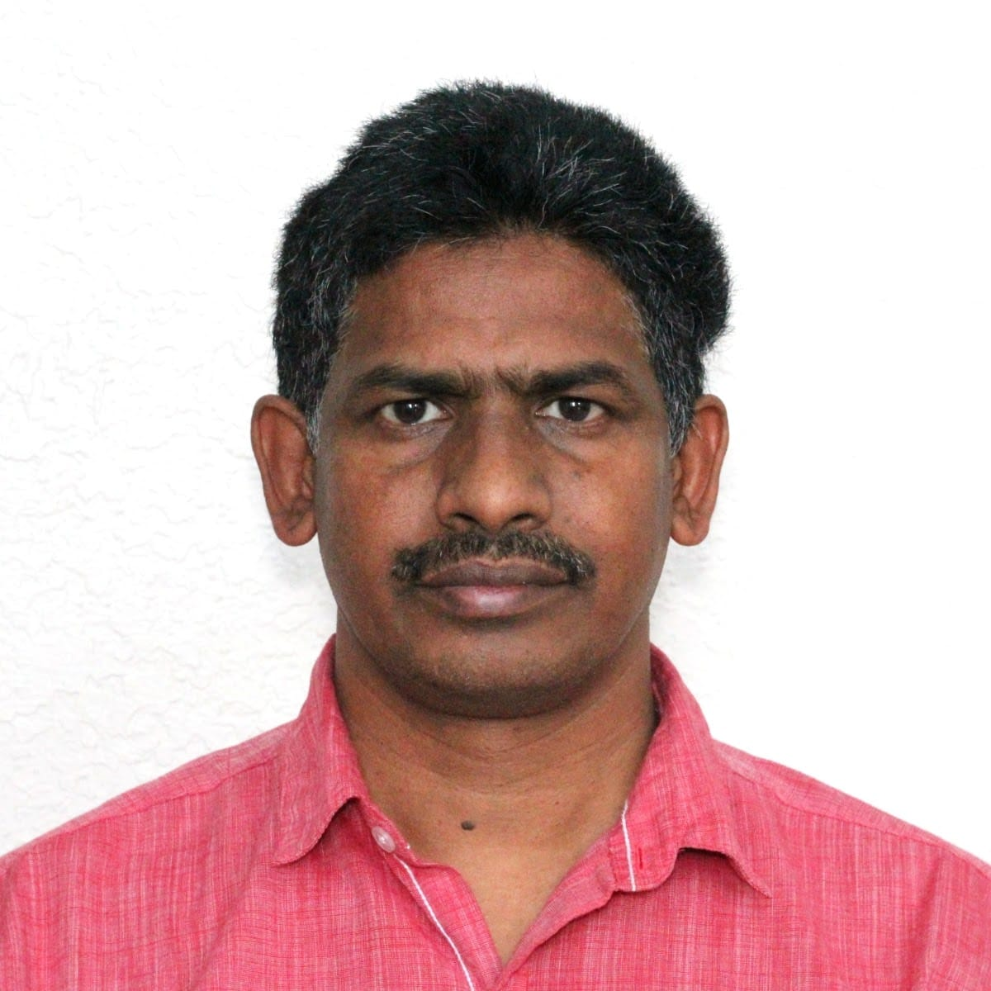
Our Team (2/6)
Balu Chedurupally
Project Engineer, Give NGO, USA
Holding a Master's in Computer Science and a rich history working in MNCs, Mr. Balu leverages his understanding of rural socio-economic backgrounds to spearhead technological advancements in education through CDLC, fostering empowerment in rural communities.
Rajanish Reddy Karla
Director, GIVE NGO, USA
Mr. Rajnish Reddy Karla leverages his experience from working at MNCs to benefit the GiveForSociety Foundation. His background in project management and technical ideation, paired with deep knowledge of the socio-economic challenges in rural areas, is pivotal in crafting effective strategies for educational upliftment. Rajnish is dedicated to utilizing innovative solutions to enhance education and foster growth in rural communities.
Venu Madhav Mamidoju –USA
Director of Onshore Operations, GIVE NGO, USA
A master in computer science with extensive experience in IT software development, Mr. Venu Madhav Mamidoju combines his technical expertise with a deep understanding of rural educational and livelihood challenges. As the Director of Onshore Operations, he spearheads initiatives to empower youth, driving innovation and applying practical insights to enhance the CDLC project. His vision and commitment are instrumental in steering the project towards success

Slide 4
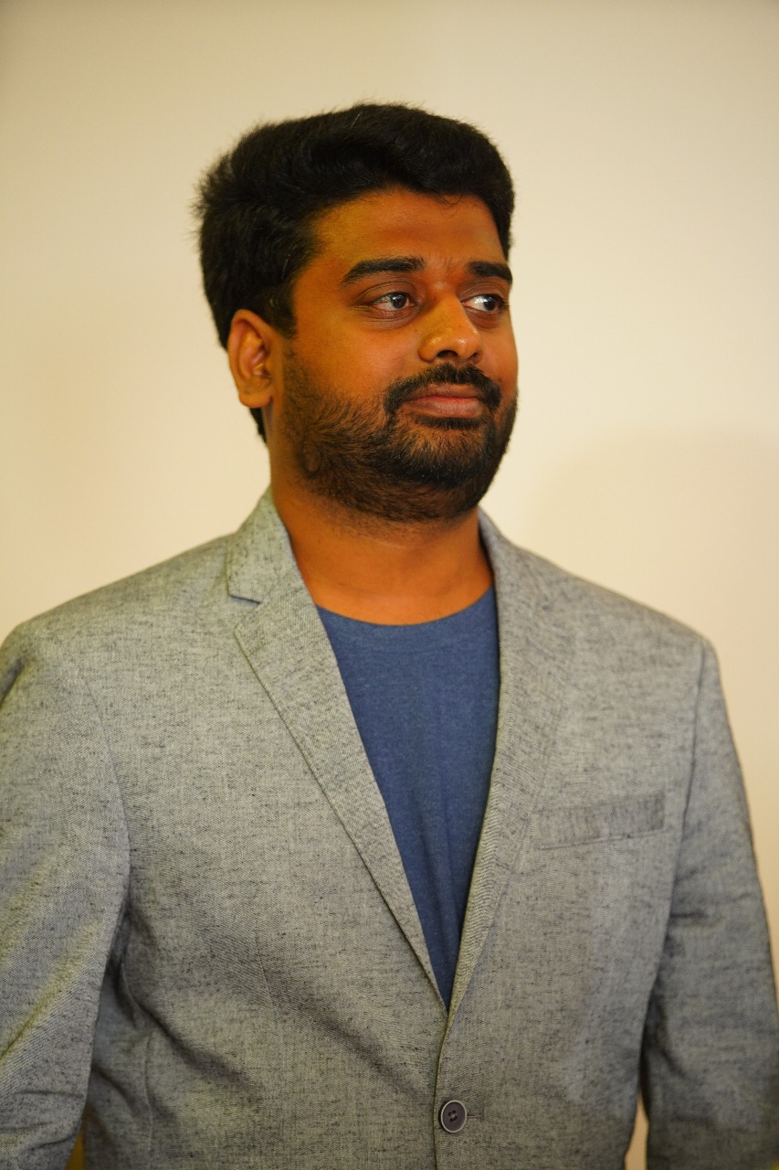
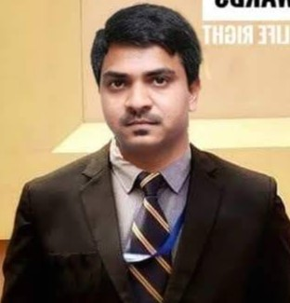
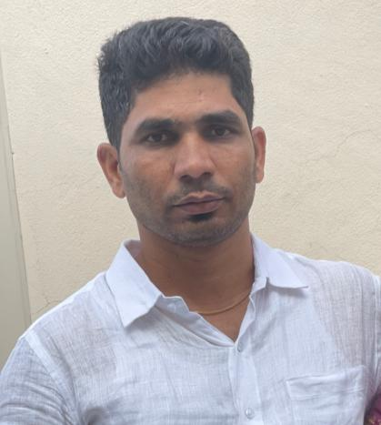
Our Team (3/6)
Abhishek Ganta
Project Lead for CDLC, Give NGO
Mr. Abhishek the Project Lead for CDLC, leverages his background in technology and his deep understanding of social issues in rural areas to foster empowerment initiatives. A Bachelor's degree holder in technology, he not only brings to the table a rich understanding of the challenges faced by rural communities but also employs his software industry experience in crafting solutions through app design and development
Arun Kumar Pillalamarri
General Secretary, Give NGO
Mr. Arun, oversees the offshore operations with a masterful grip, owing to his profound educational background in technology. Arun has spent considerable time understanding and analyzing the socio-economic backwardness prevalent in rural communities. Right from his student days, he has been actively engaged in initiatives focusing on education and health hygiene. Recognized for his adept administrative capabilities, he has a proven track record of successfully executing ground-level projects, truly embodying the spirit of empowerment and upliftment.
Chandrashekar Reddy
Project Engineer – CDLC, Give NGO
Mr. Chandra the dedicated Project Lead for CDLC, holds a bachelor's degree in technology and stands as a beacon of support for the farming community. Leveraging his profound understanding of rural agricultural issues, he has crafted efficient solutions to uplift farmers. Chandrashekar is not just a project lead but a true ally to the farming community, spearheading initiatives that foster sustainability and prosperity in rural regions.

Slide 5
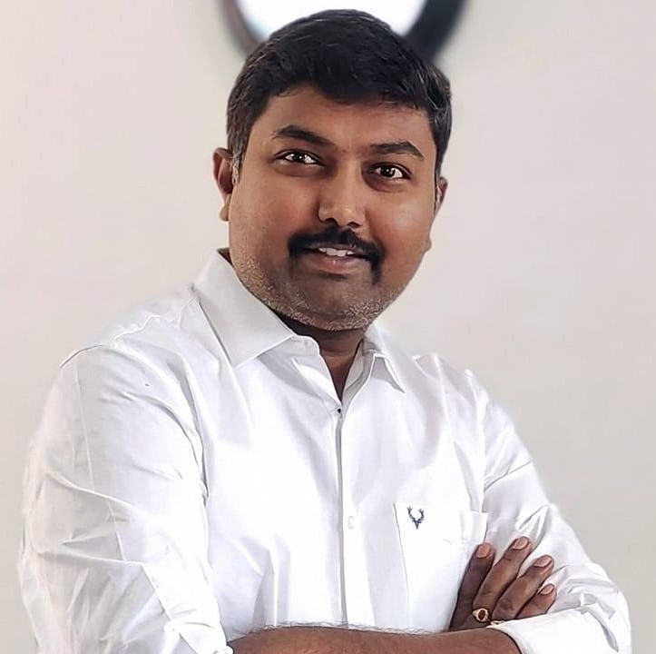
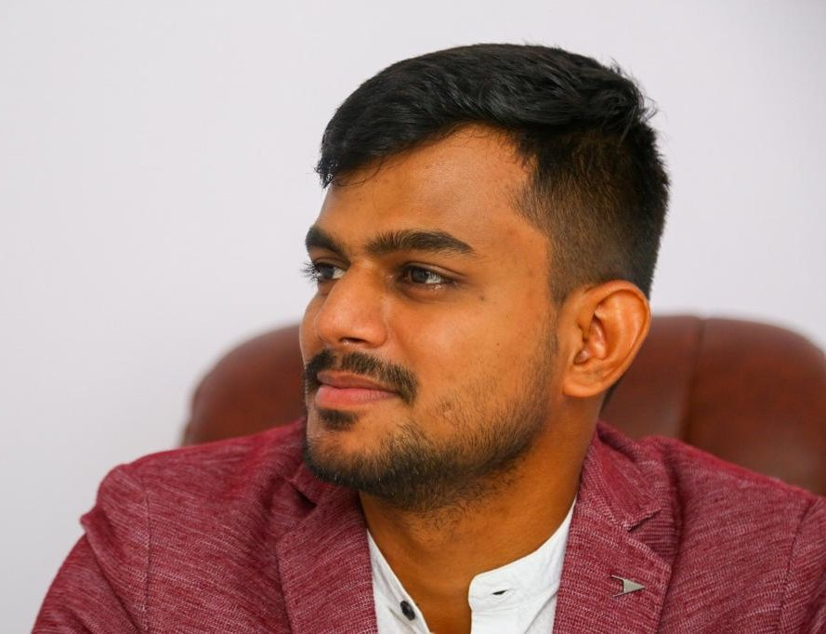
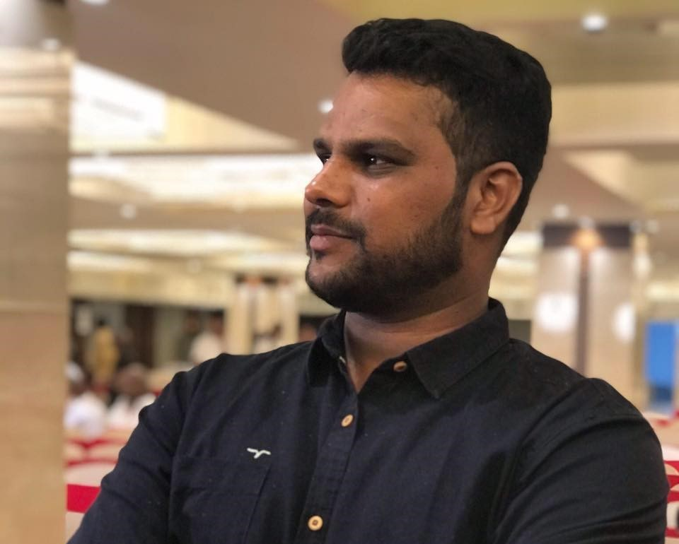
Our Team (4/6)
Sai Krishna Chilukuri
Director, Operation Lead for CDLC, Telangana.
Mr. Sai Krishna Project Lead for CDLC, bringing essential education programs to rural and tribal communities in Telangana. With a deep understanding of the needs and dynamics of these areas, he has been the force behind impactful projects like the 'Back to School' program, showing great leadership and a heart for empowering young people.
Sai Eshwar Reddy
Project Engineer, CDLC, Give NGO
Mr. Eshwar, the linchpin of the CDLC initiative as Project Engineer, is channeling his profound understanding of rural dynamics to eradicate the technology gap between rural and urban areas. His vision goes beyond bridging gaps; it's about forging pathways of opportunity and empowerment for rural youth through focused upskilling initiatives, transforming rural locales into modern hubs of progress and potential.
ParshuRam Goud
Project Engineer for CDLC
Mr. ParshaRam, leverages his background as a software engineer to actively address social backwardness in rural villages. Harnessing his extensive experience in the software industry for designing applications, he has dedicated his career to empowerment initiatives since his student days, illustrating a long-standing commitment to fostering growth and development in the community.

Slide 6
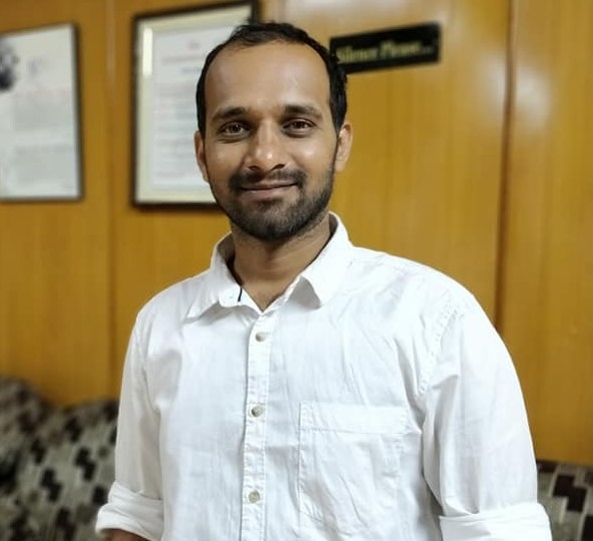
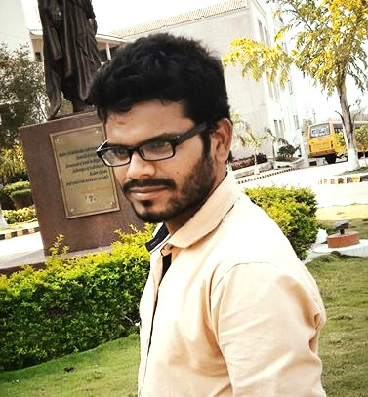
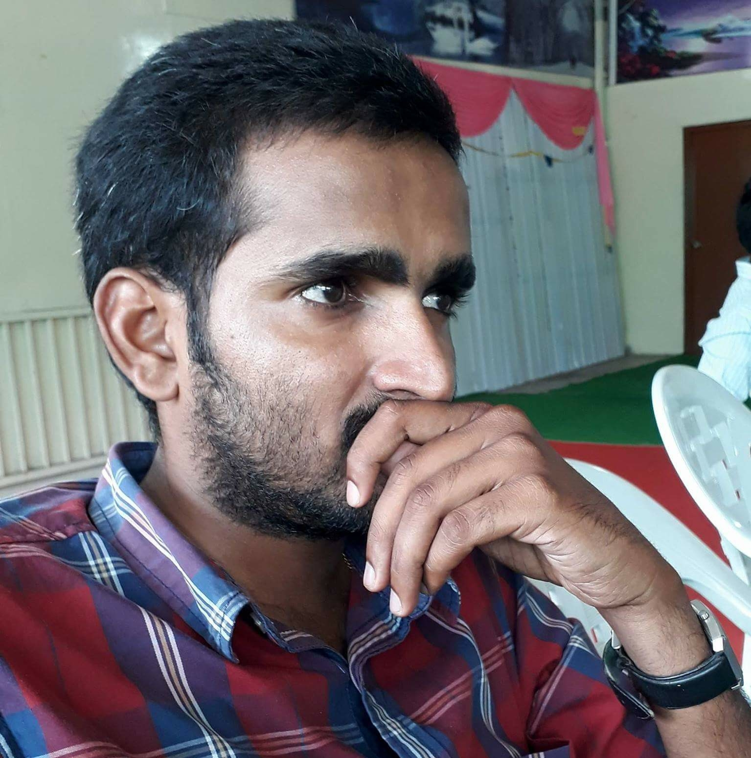
Our Team (5/6)
Akhilesh Reddy Kasani
Treasurer, Give NGO, Telangana.
Mr. Akhilesh, the Project Engineer for CDLC, has been vital in bringing educational projects to life from the ground up. With a deep understanding of the educational sector, he has been a key force behind the 'Back to School' programs, helping countless underprivileged students pursue their education.
Bhanu Goud Bathini
Project Engineer, CDLC, Give NGO
Mr. Bhanu – Project Engineer, CDLC, couples his role as a software engineer with a deep-rooted understanding of the societal dynamics prevailing in rural setups. Leveraging his industry expertise, he ingeniously designs applications targeting empowerment and development in rural communities, making strides in diminishing social backwardness
Mahipal Reddy
Project Engineer for CDLC
Mr. Mahipal - the Project Engineer for CDLC, possesses deep expertise in grassroots-level issues affecting farmers. Leveraging his substantial knowledge, he aids them by introducing innovative techniques, thus standing as a beacon of support and help in the farming community

Slide 7
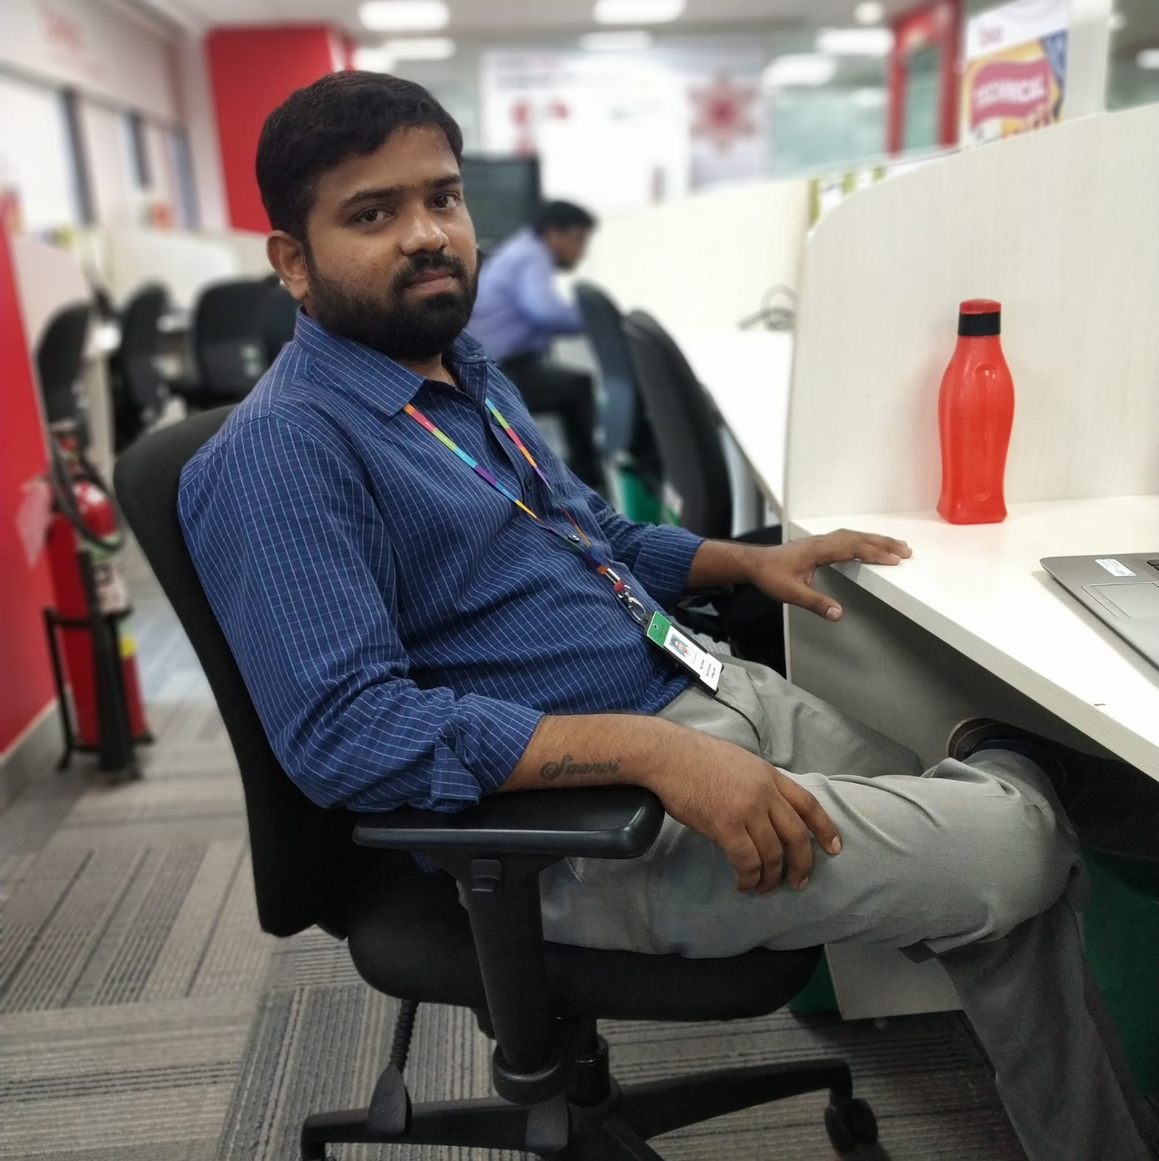
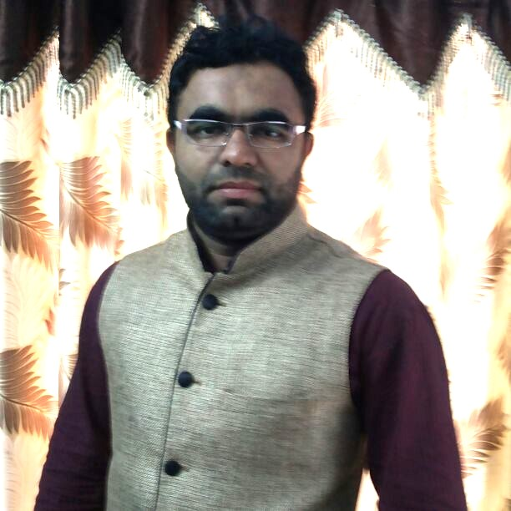
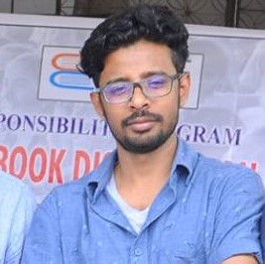
Our Team (6/6)
Raju Mokide
Project Engineer, CDLC, Give NGO
A seasoned software engineer, Mr. Raju masterfully merges technical prowess with a profound understanding of rural socio-political landscapes. At CDLC, he architects applications tailored to meet the unique needs and alleviate the challenges of rural communities. Leveraging his intricate knowledge of government policies, he spearheads initiatives to foster political awareness and empowerment, nurturing a grassroots movement towards informed and active participation in governance.
Mohammed Abdul Hakim
Financial Operations Lead, CDLC, Give NGO
Holding a Masters in Business Administration, Mr. Hakim brings to the table 15 years of rich experience in social activities, particularly in rural development. His vast knowledge in addressing the educational gaps and fostering youth empowerment in rural areas is instrumental in steering the financial operations of the initiative.
Mohd Altaf Ur Rahman
Project Engineer, NGO Give -USA
Combining technical proficiency with a heartfelt commitment to community development, Mr. Altaf leverages his extensive background in IT and project management to address educational challenges in rural areas. His early involvement in social initiatives and a deep understanding of rural dynamics make him an invaluable asset to the team, bringing innovative and practical solutions to the fore.

